Slide 1
BIL 108E Introduction to Scientific and Engineering Computing
ASST. PROF. DR. İPEK AKIN
Creating Arrays

Slide 2
INTRODUCTION
The array is a fundamental form that MATLAB uses to store or manipulate data.
Array is a list of numbers arranged in columns and/or rows.
The simplest array (1 dimensional = vector) is a row or column of numbers.
More complex array (2 dimensional = matrice) is collection of numbers arranged in rows or columns.

Slide 3
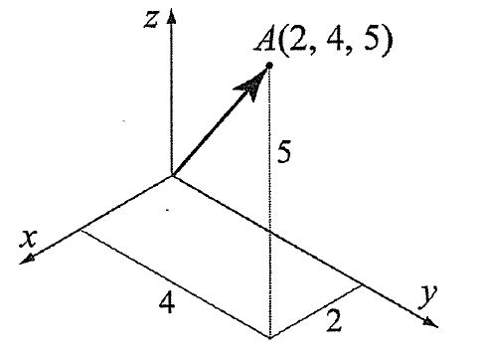
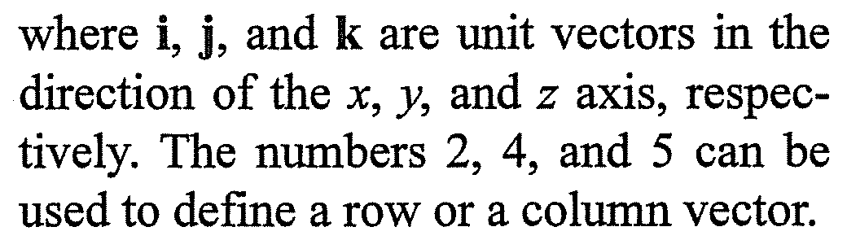
Creating One Dimensional Array (Vector)
Position of A
r_{A} = 2i + 4j + 5k

Slide 4
Creating One Dimensional Array (Vector)
Any list of numbers can be set up as a vector.
Year | 1984 | 1986 | 1988 | 1990 | 1992 | 1994 | 1996
Population (Millions) | 127 | 130 | 136 | 145 | 158 | 178 | 211
Population growth data that can be used to create 2 lists of numbers;
Years
Population
Each list can be entered as elements in a vector with the numbers placed in a row or in a column.

Slide 5
Creating One Dimensional Array (Vector)
In MATLAB, a vector is created by assigning the elements of the vector to a variable → can be done in different ways depending on the source of the info that is used for the elements of the vector.
When a vector contains specific numbers that are known (e.g.coordinates of point A), the value of each element is entered directly.
Each element can also be a mathematical expression that can include predefined variables, numbers and functions.

Slide 6
Creating a vector from a known list of numbers
The vector is created by typing the elements (numbers) inside [ ]
variable_name = [type vector elements]
Row Vector Type elements in with a space or , btw the elements inside the [ ]
Column Vector [ + enter elements with a ; or press Enter key after each element + ]

Slide 7
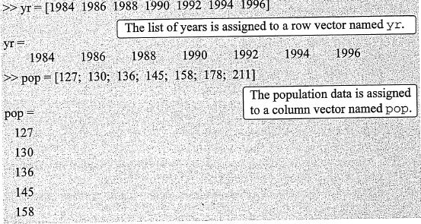
Creating a vector from a known list of numbers
Year | 1984 | 1986 | 1988 | 1990 | 1992 | 1994 | 1996
Population (Millions) | 127 | 130 | 136 | 145 | 158 | 178 | 211

Slide 8
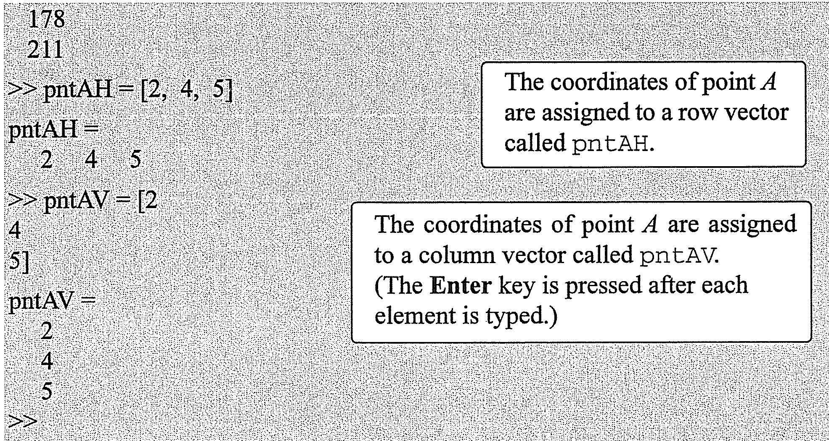

Slide 9
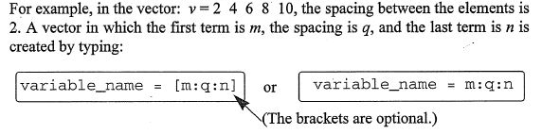
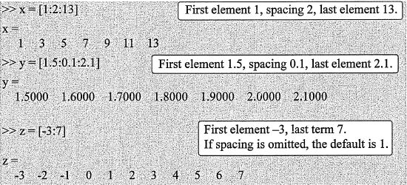
Creating a vector with constant spacing by specifying the first term, the spacing, and the last term
First term: m
Spacing: q
Last term: n

Slide 10
Creating a vector with constant spacing by specifying the first term, the spacing, and the last term

Slide 11
If the numbers m, q and n are such that the value of n can not be obtained by adding q’s to m, then (for positive n) the last element in the vector will be the last number that does not exceeds n.

Slide 12
Creating a vector with constant spacing by specifying the first and last terms, and the number of terms
First element: xi
Last element: xf
Number of elements: n
Created by typing linspace command
variable_name = linspace (xi,xf,n)
>> va=linspace(0,8,6)
va=
0 1.6000 3.2000 4.8000 6.4000 8.0000
First element: 0
Last element: 8
Number of elements: 6

Slide 13
>> vb=linspace(30,10,11)
vb=
30 28 26 24 22 20 18 16 14 12 10
First element: 30
Last element: 10
Number of elements: 11
>> u=linspace(49.5,0.5)
u=
Columns 1 through 10
49.5000 49.0051 48.5101 48.0152 47.5202 47.0253 46.5303
46.0354 45.5404 45.0455
……………..
Columns 91 through 100
4.9545 4.4596 3.9646 3.4697 2.9747 2.4798 1.9848 1.4899
0.9949 0.5000
First element: 49.5 , last element: 0.5
If the # of elements is omitted, the default is 100

Slide 14
Creating Two Dimensional Array (Matrix)
Has numbers in rows and columns
Matrices can be used to store information like in a table.
Matrices play an important role in linear algebra and are used in science and engineering to describe many physical quantities.

Slide 15
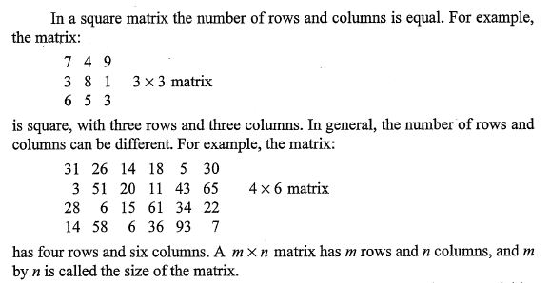
Creating Two Dimensional Array (Matrix)

Slide 16
Creating Two Dimensional Array (Matrix)
[ + type the first row separating the elements with spaces or commas
To type the next row;
; or Enter
Type ] at the end of the last row.
variable_name = [1st row elements; 2nd row elements; 3rd row elements; ………………; last row elements]
Elements can be numbers, mathematical expressions (numbers, predefined variables, functions

Slide 17
Creating Two Dimensional Array (Matrix)
All the rows must have the same number of elements.
If an element is 0, it has to be entered as such.

Slide 18
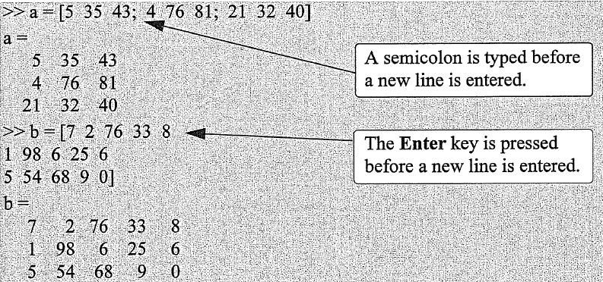
Creating Matrices

Slide 19
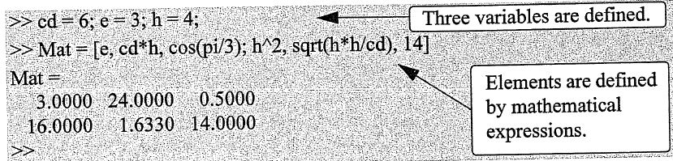
Creating Matrices

Slide 20
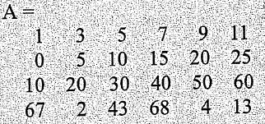
Creating Matrices
Rows of a matrix can also be entered as vectors using the notation for creating vectors with constant spacing; or the linspace command.
For example;
>> A=[1:2:11; 0:5:25; linspace(10,60,6); 67 2 43 68 4 13]
In this example, the first two rows were entered as vectors using the notation of constant spacing, the 3rd row was entered using linspace command, and in the last row the elements were entered individually.

Slide 21
The zeros, ones and eye commands
The zeros (m,n)
Create a matrix with m rows and n columns, in which all the elements are numbers 0 and 1, respectively.
The ones (m,n)
The eye (n)
Create a square matrix with n rows and n columns, in which the diagonal elements are equal to 1, and rest of the elements are 0 → Identity Matrix

Slide 22
The zeros, ones and eye commands
>> zr = zeros(3,4)
zr =
0 0 0 0
0 0 0 0
0 0 0 0
>> idn = eye (5)
idn =
1 0 0 0 0
0 1 0 0 0
0 0 1 0 0
0 0 0 1 0
0 0 0 0 1
>> ne = ones(4,3)
ne =
1 1 1
1 1 1
1 1 1
1 1 1

Slide 23
Notes About Variables in MATLAB
All variables (scalar, vector, matrix) in MATLAB are arrays.
A scalar is an array with one element
A vector is an array with row or one column of elements
A matrix is an array with elements in rows and columns
The variable is defined by the input when the variable is assigned.
No need to define the size of the array
Single element for a scalar
A row or a column of elements for a vector
A 2-dimensional array of elements for a matrix
Once a variable exists as a scalar, vector, or matrix, it can be changed to be any other size, or type, of variable.

Slide 24
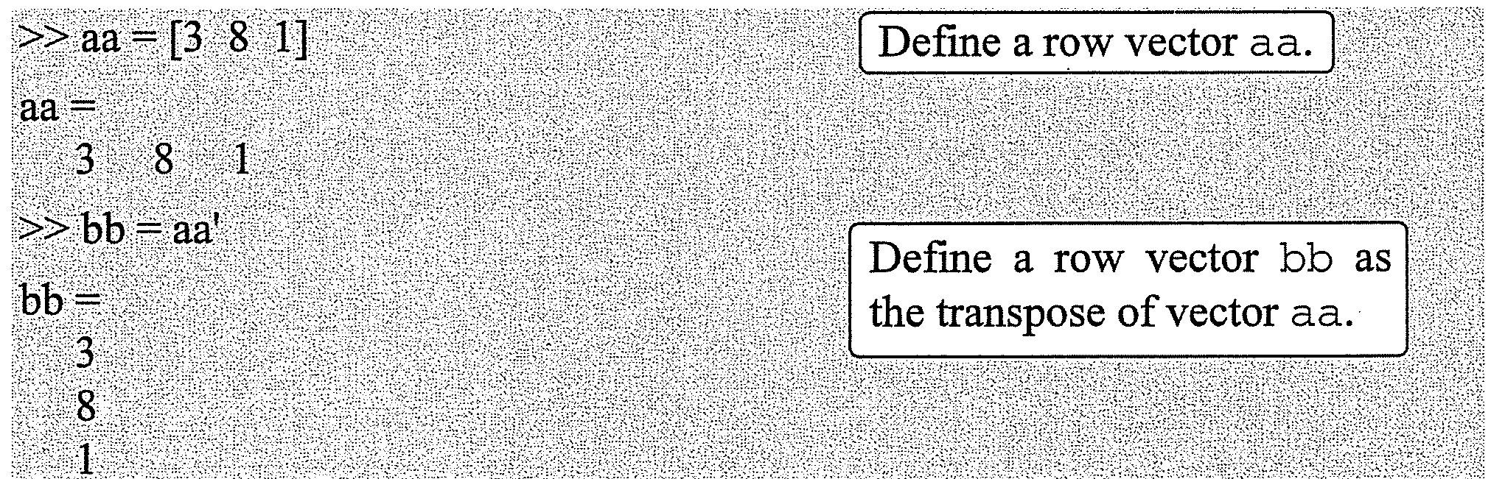
The Transpose Operator
When applied to a vector, switches a row (column) vector to a column (row) vector
When applied to a matrix, switches the rows (columns) to columns (rows)
The transpose operator is applied by typing a single quote ’ following the variable to be transposed.
Example-1

Slide 25
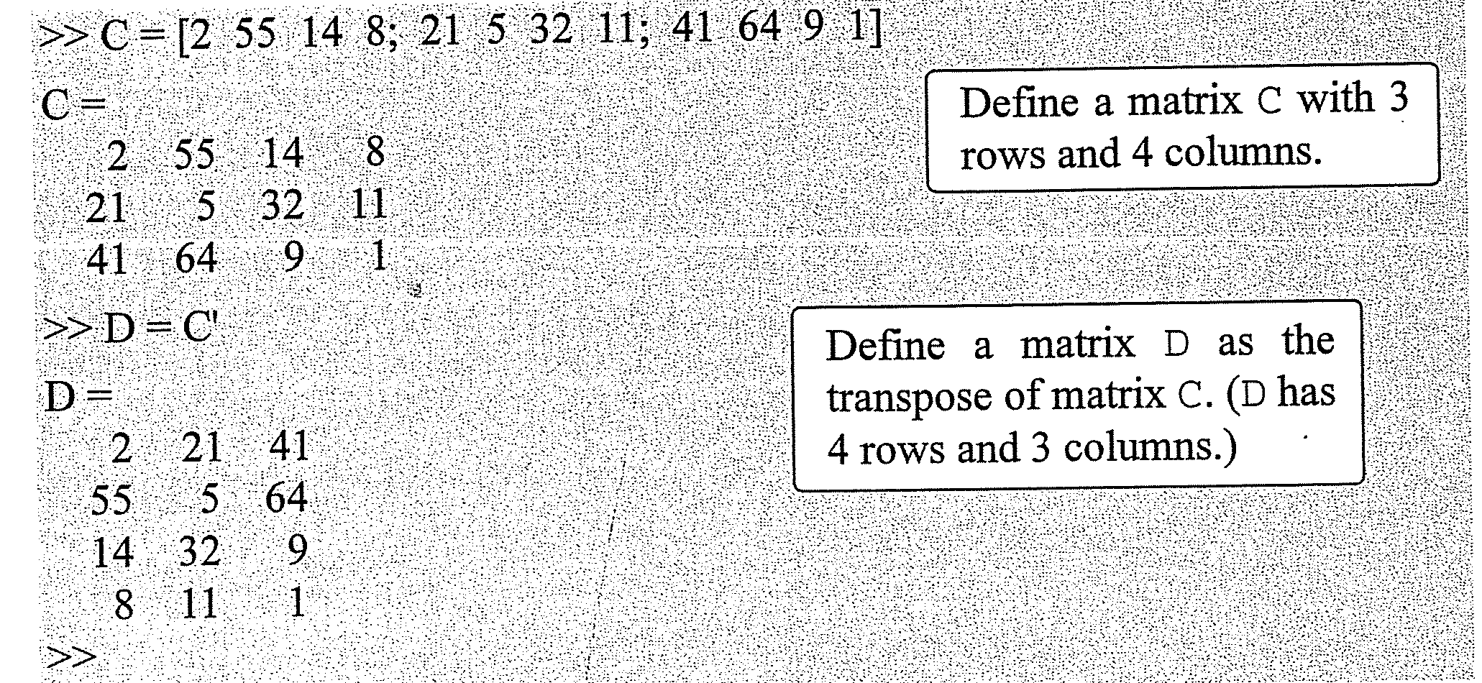
Example-2

Slide 26
Array Addressing
Elements in an array (either vector or matrix) can be addressed individually or in subgroups.
Redefine only some of the elements
Use specific elements in calculations
When a subgroup of the elements is used to define a new variable

Slide 27
Array Addressing - Vector
The address of an element in a vector is its position in the row (or column).
Vector name: ve
ve (k) refers to the element in position k
The first position is 1
If the vector ve has 9 elements → ve = 35 46 78 23 5 14 81 3 55
then
ve(4) = 23, ve(7) = 81, ve(1) = 35
A single vector element v(k) can be used just as a variable.
The value of only one element of a vector can be changed by reassigning a new value to a specific adress → v(k) = value

Slide 28
Array Addressing - Vector
>> VCT = [35 46 78 23 5 14 81 3 55] Define a vector
VCT =
35 46 78 23 5 14 81 3 55
>> VCT(4) Display the fourth element
ans =
23
>> VCT (6) = 273 Assign a new value to the sixth element
>> VCT = [35 46 78 23 5 273 81 3 55] The whole vector is displayed
>> VCT(2) + VCT(8) Assign a new value to the sixth element
Use the vector elements in mathematical expressions
>> VCT(5)^VCT(8) + sqrt(VCT(7))
ans =
134

Slide 29
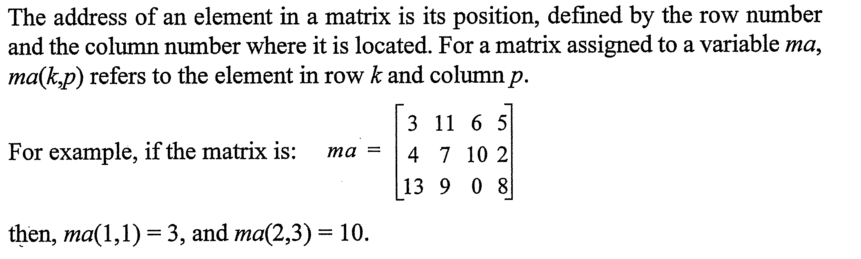
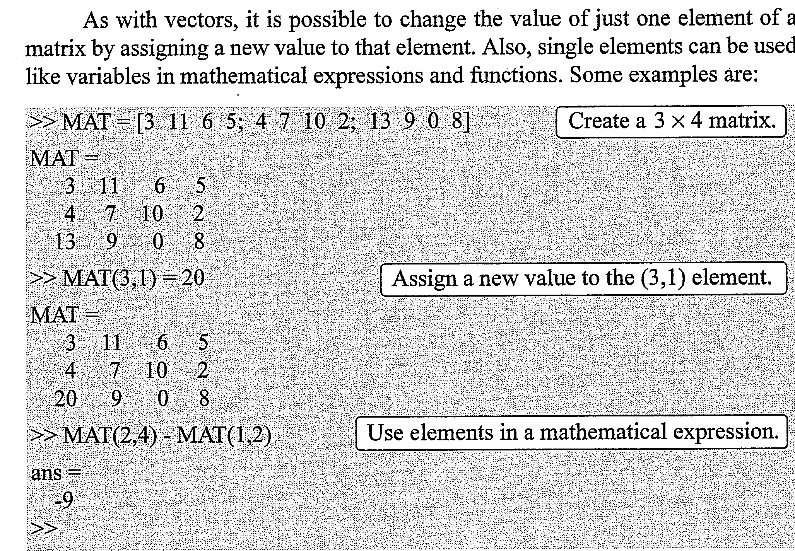
Array Addressing – Matrix

Slide 30
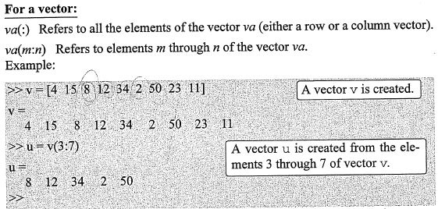
Using a Colon: For a Vector

Slide 31
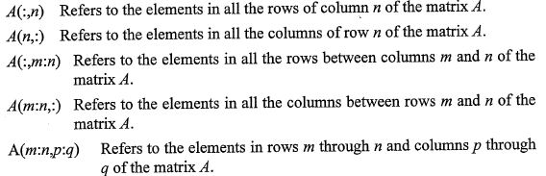
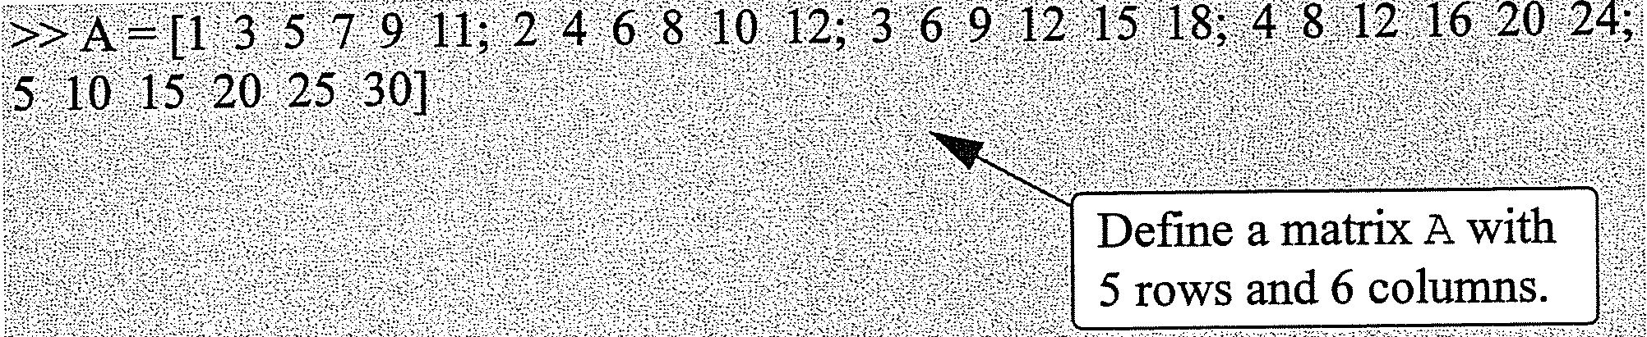
Using a Colon: For a Matrix

Slide 32
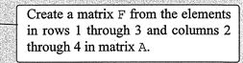
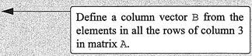
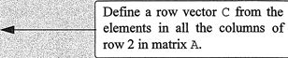
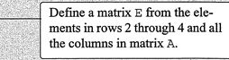
A =
>>F=A(1:3,2:4)
1 | 3 | 5 | 7 | 9 | 11
2 | 4 | 6 | 8 | 10 | 12
3 | 6 | 9 | 12 | 15 | 18
4 | 8 | 12 | 16 | 20 | 24
5 | 10 | 15 | 20 | 25 | 30
F =
3 | 5 | 7
4 | 6 | 8
6 | 9 | 12
>>B=A(:,3)
B =
5
6
9
12
15
>>C=A(2,:)
C =
2 4 6 8 10 12
>>E=A(2:4,:)
E =
2 | 4 | 6 | 8 | 10 | 12
3 | 6 | 9 | 12 | 15 | 18
4 | 8 | 12 | 16 | 20 | 24

Slide 33
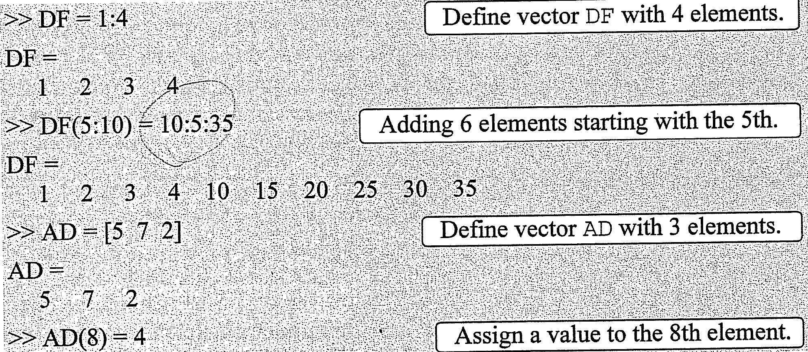
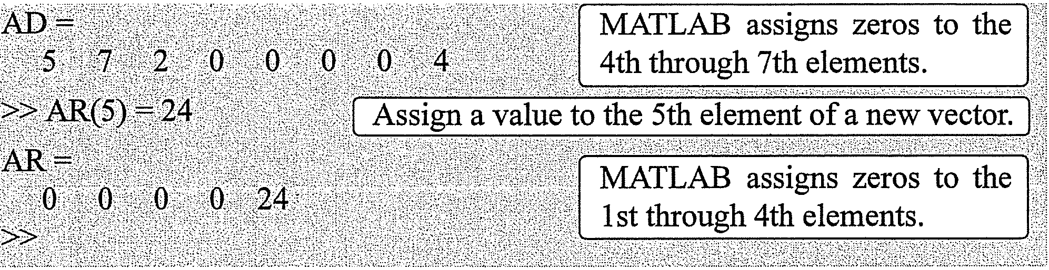
Adding Elements to Existing Variables

Slide 34
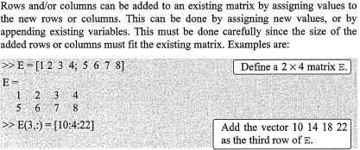
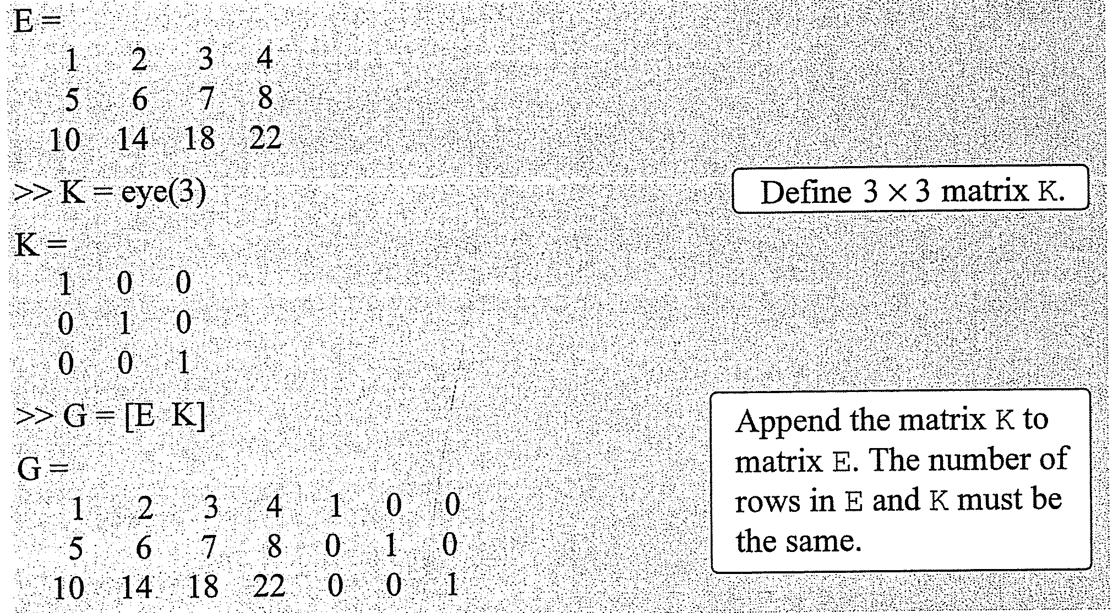
Adding Elements to a Matrix

Slide 35
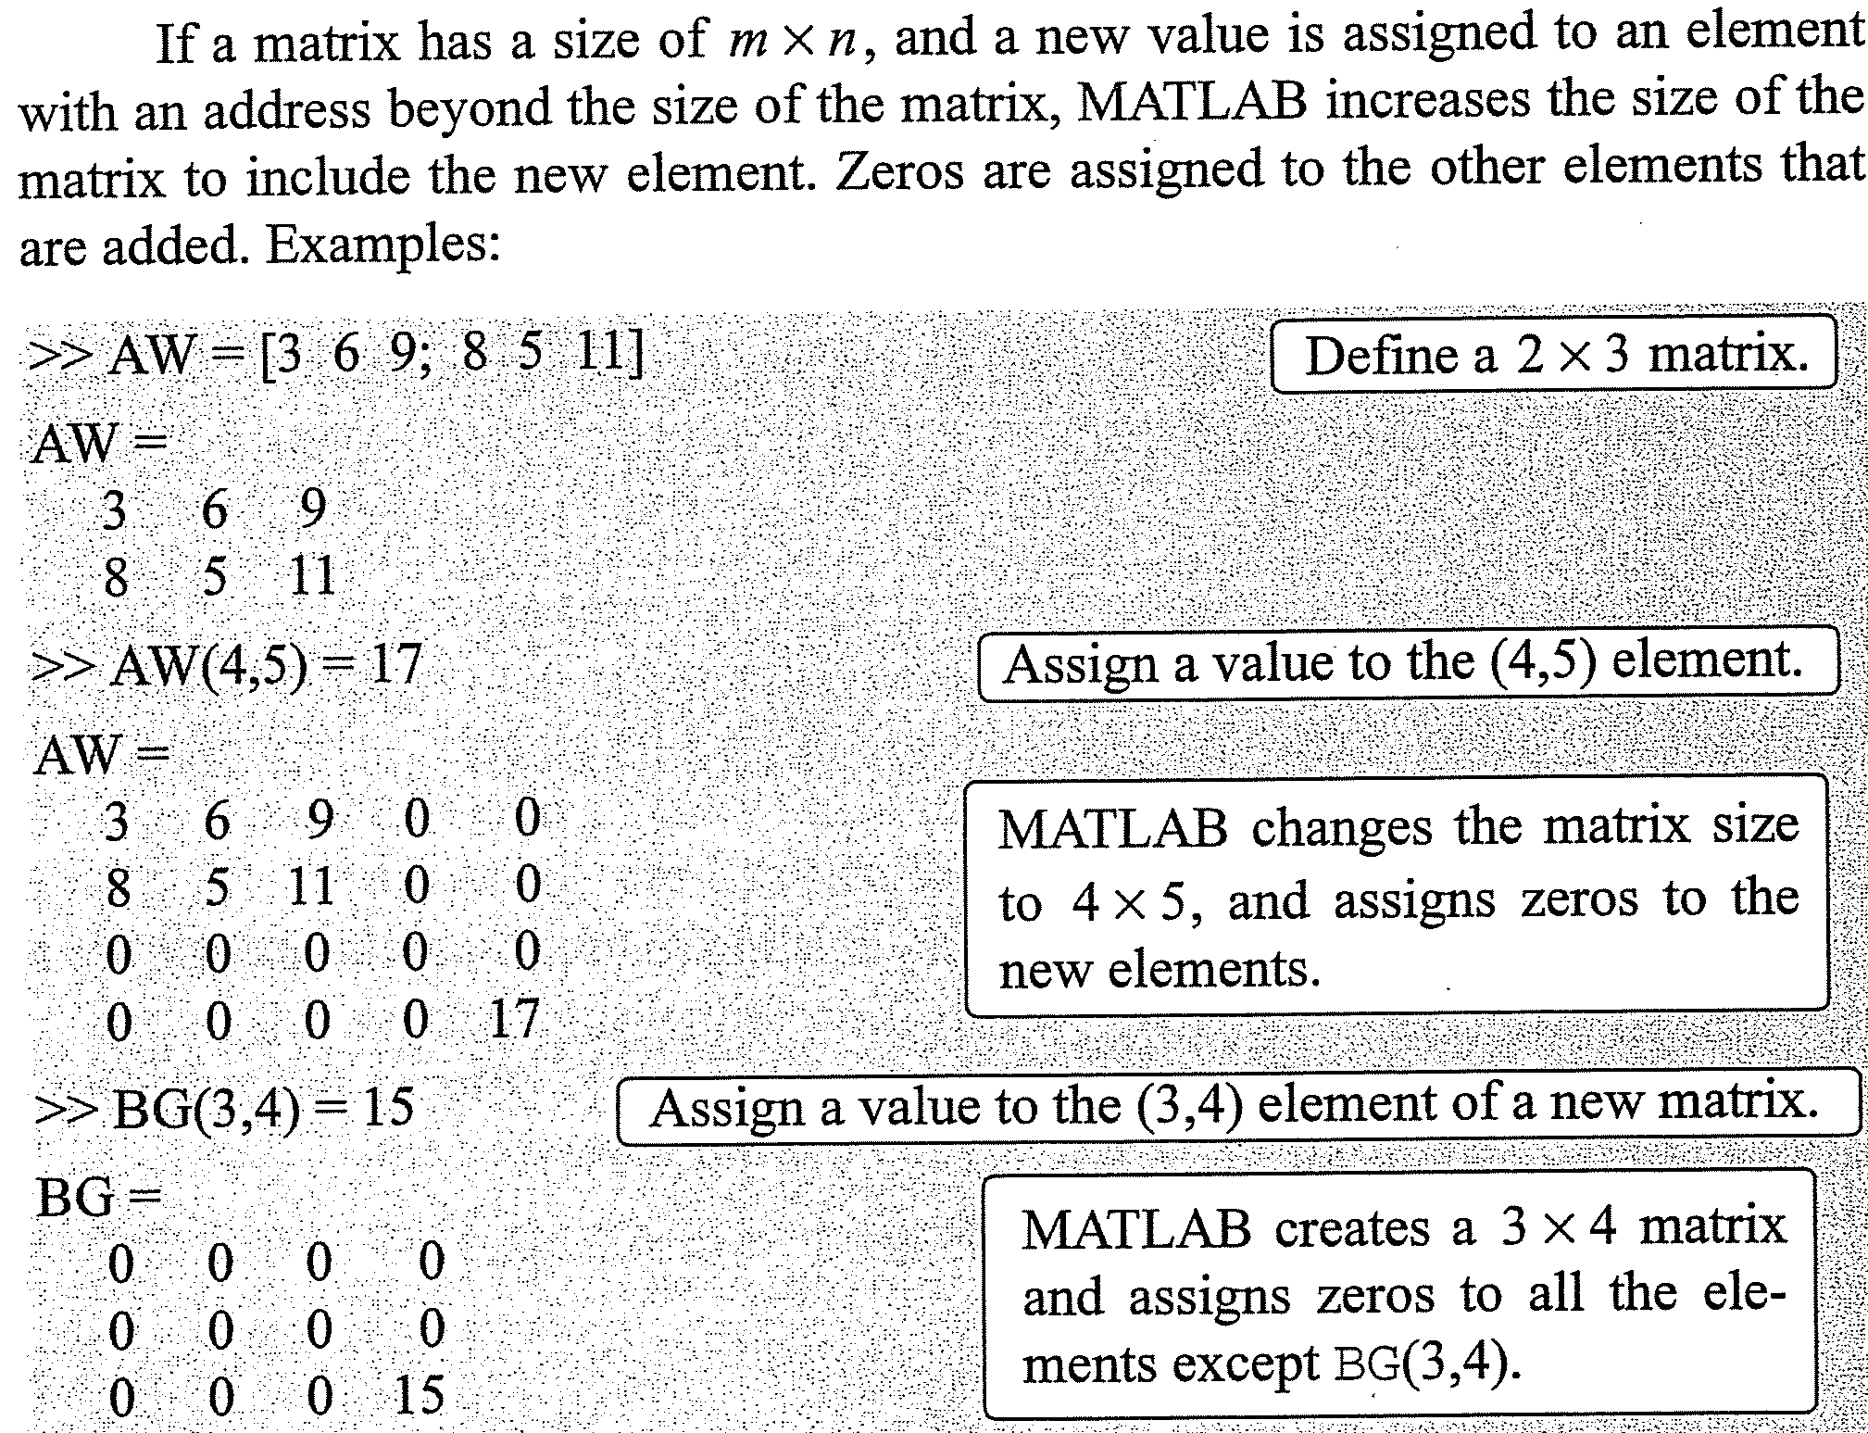
Adding Elements to a Matrix

Slide 36
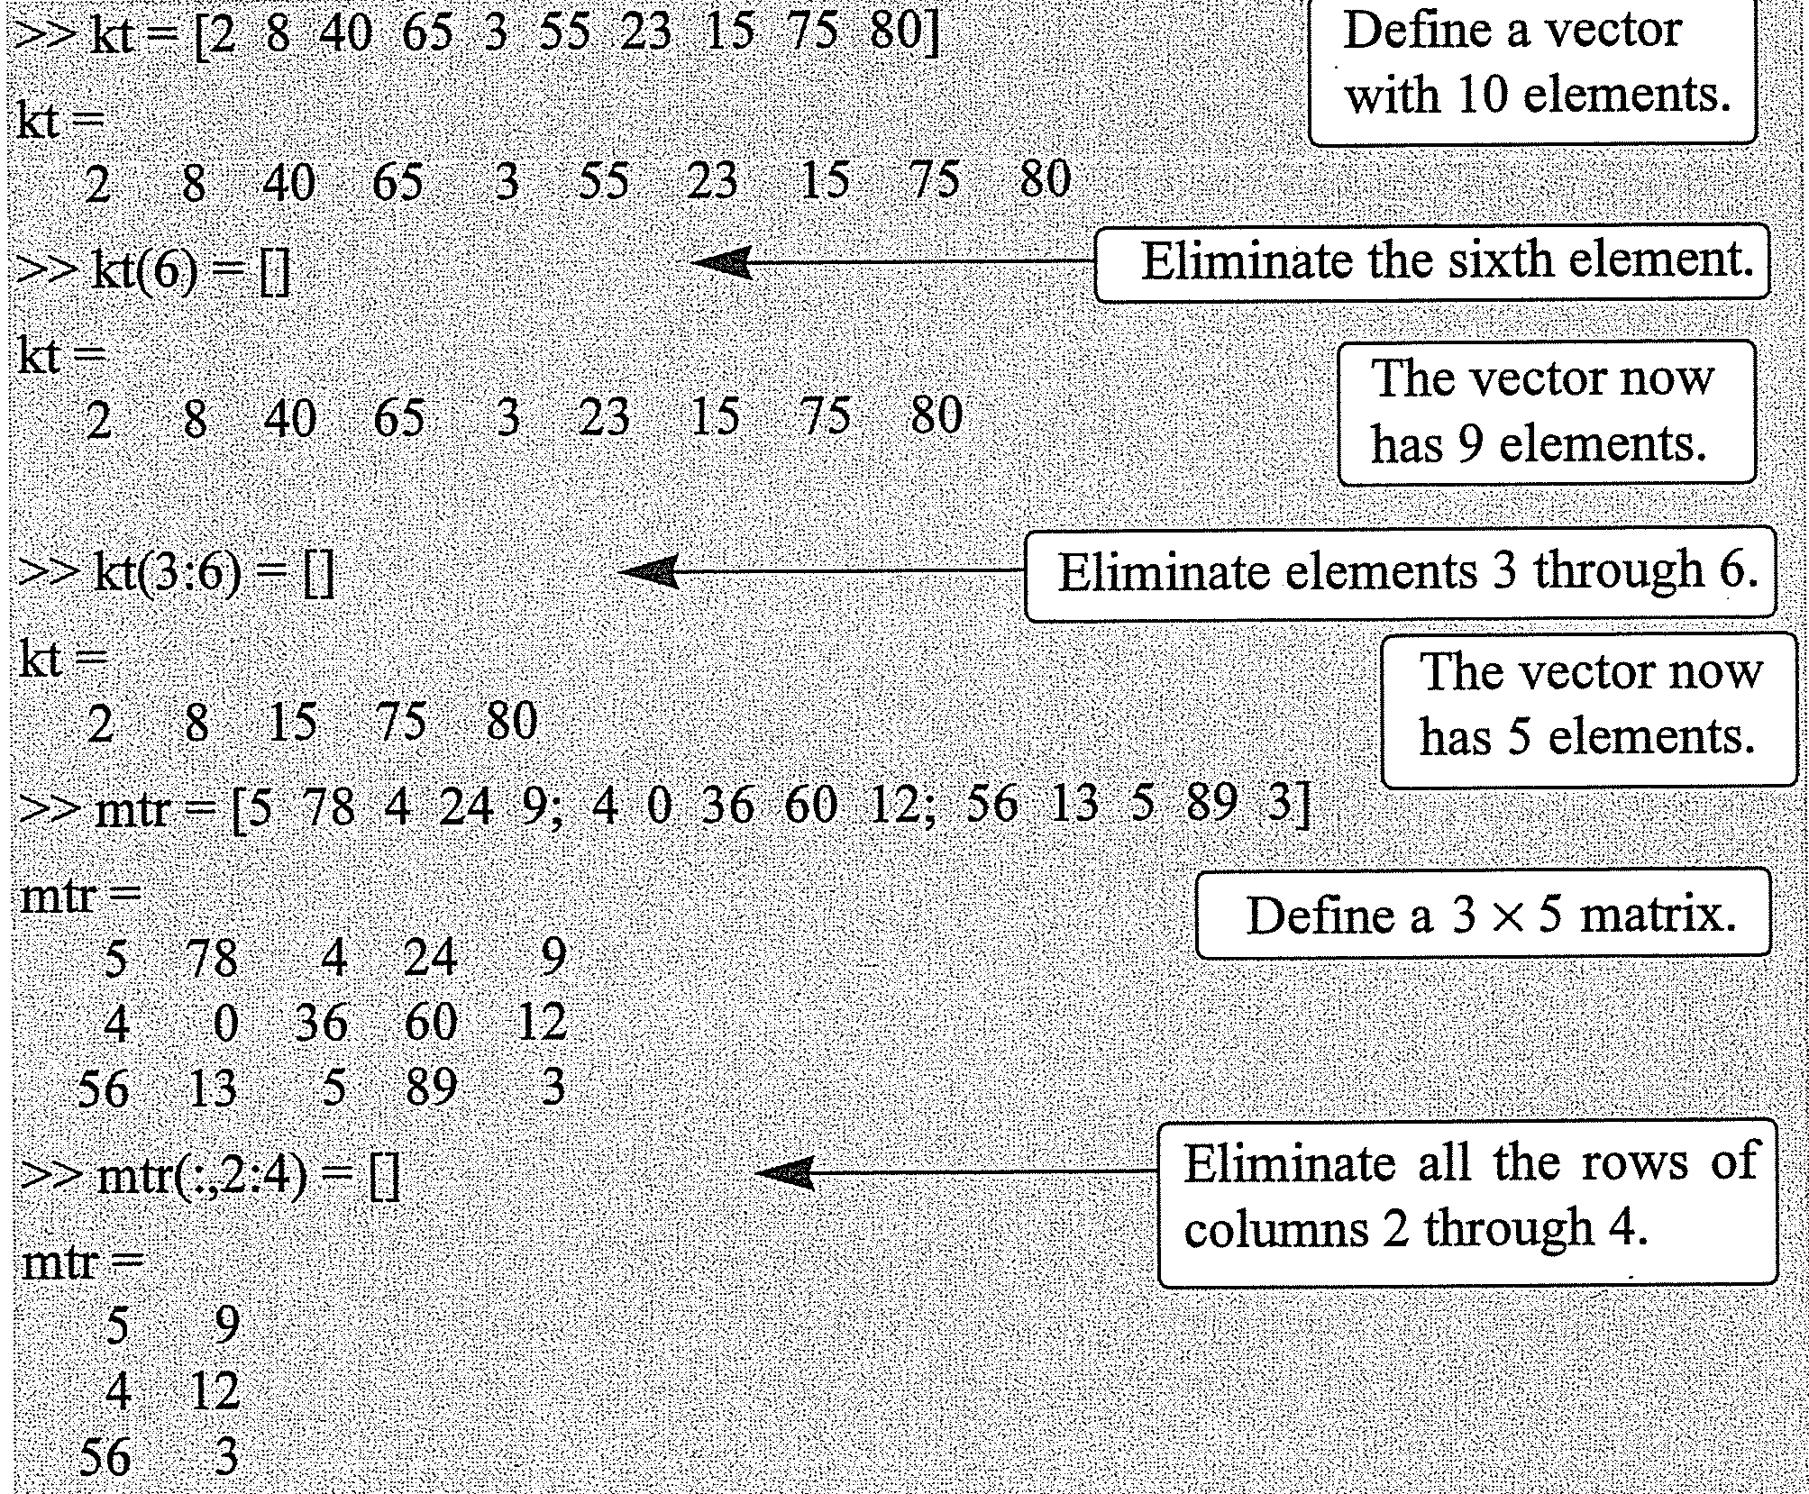
Deleting Elements
An element or a range of elements, of an existing variable can be deleted by reassigning nothing to these elements. This is done by using [ ] with nothing typed in btw them.

Slide 37
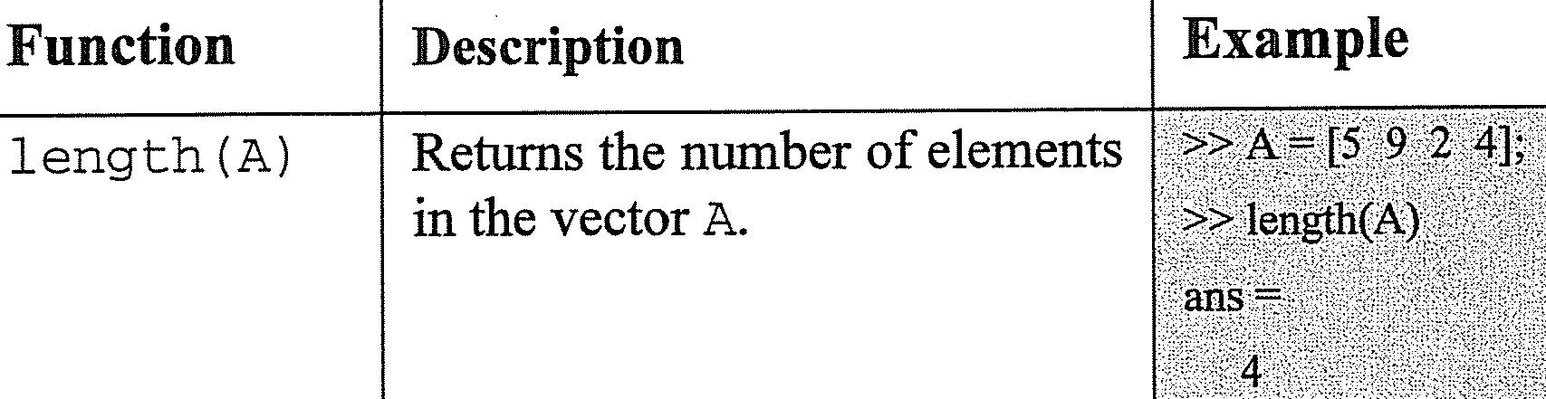
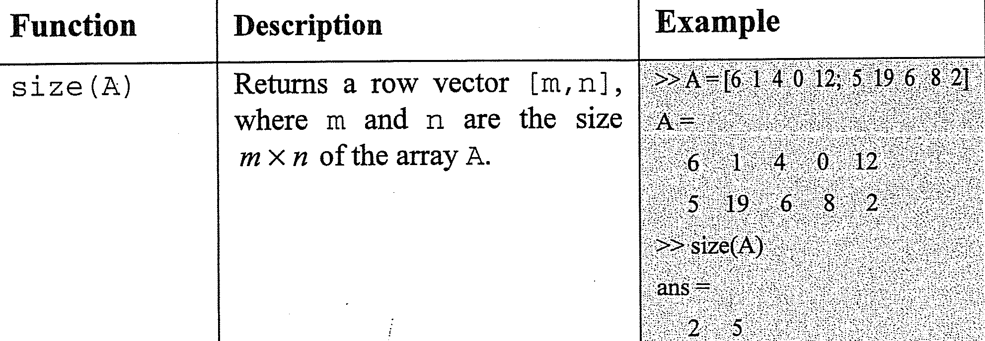
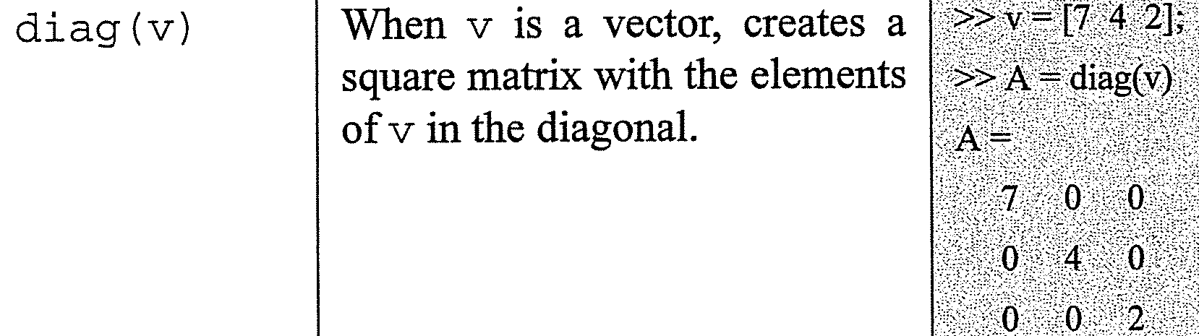
Built-In Functions for Handling Arrays

Slide 38
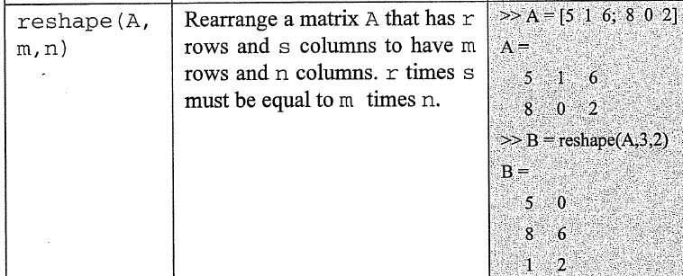
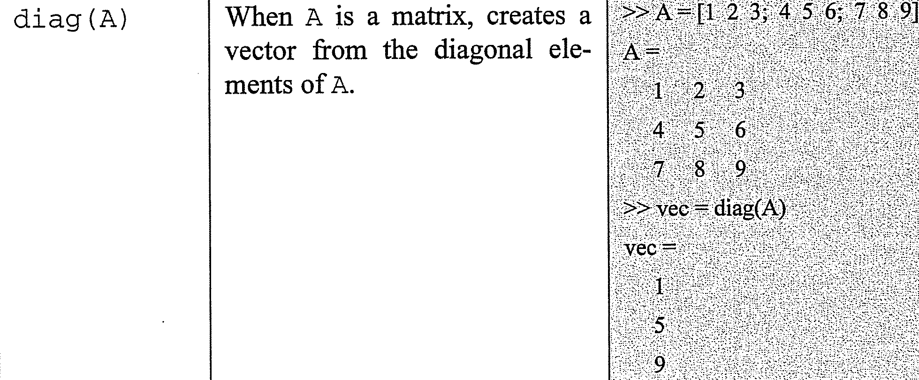
Built-In Functions for Handling Arrays

Slide 39
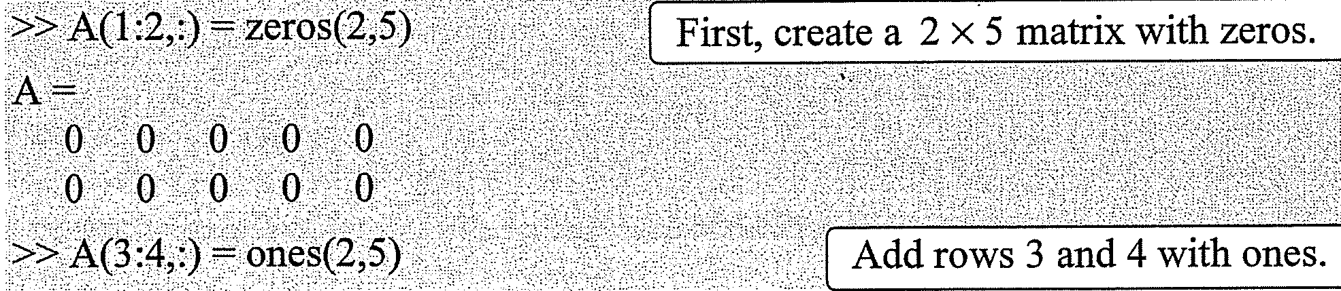
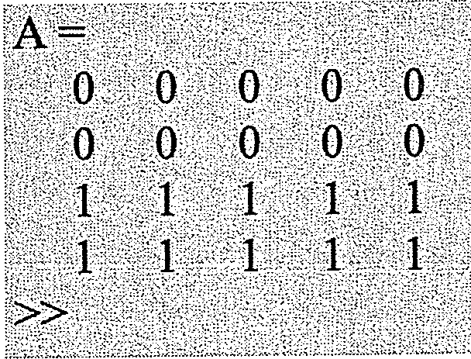
Example-1

Slide 40
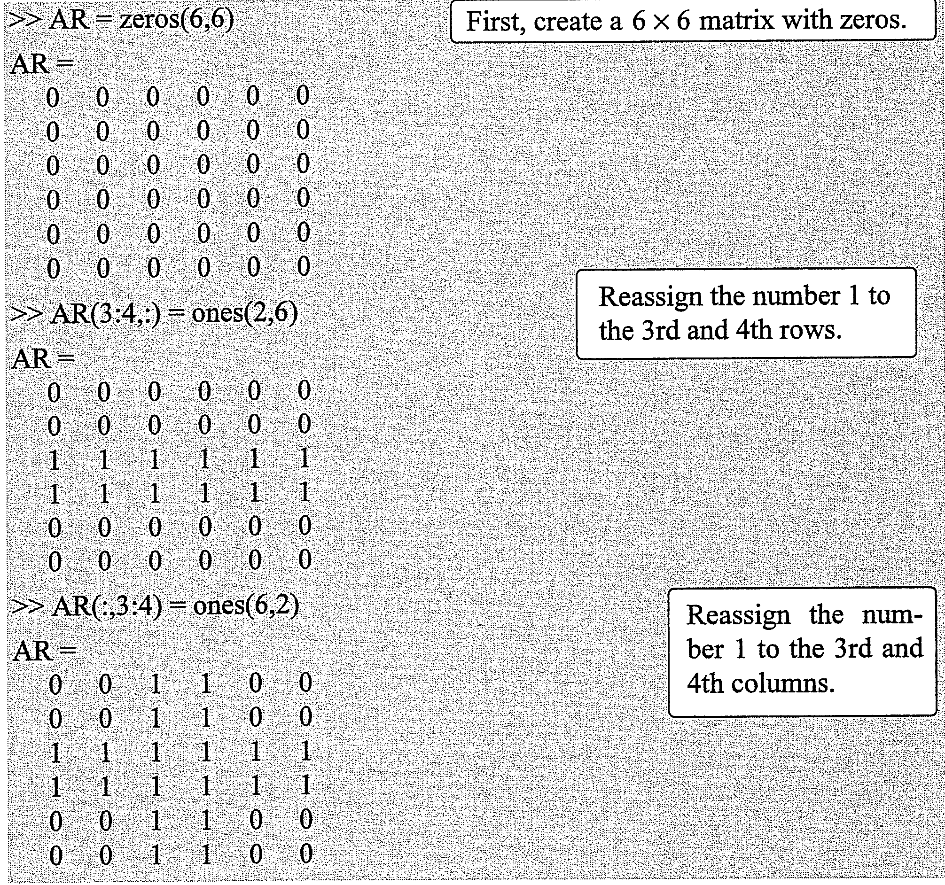
Example-2

Slide 41
BIL 108E Introduction to Scientific and Engineering Computing
ASST. PROF. DR. İPEK AKIN
Mathematical Operations with Arrays

Slide 42
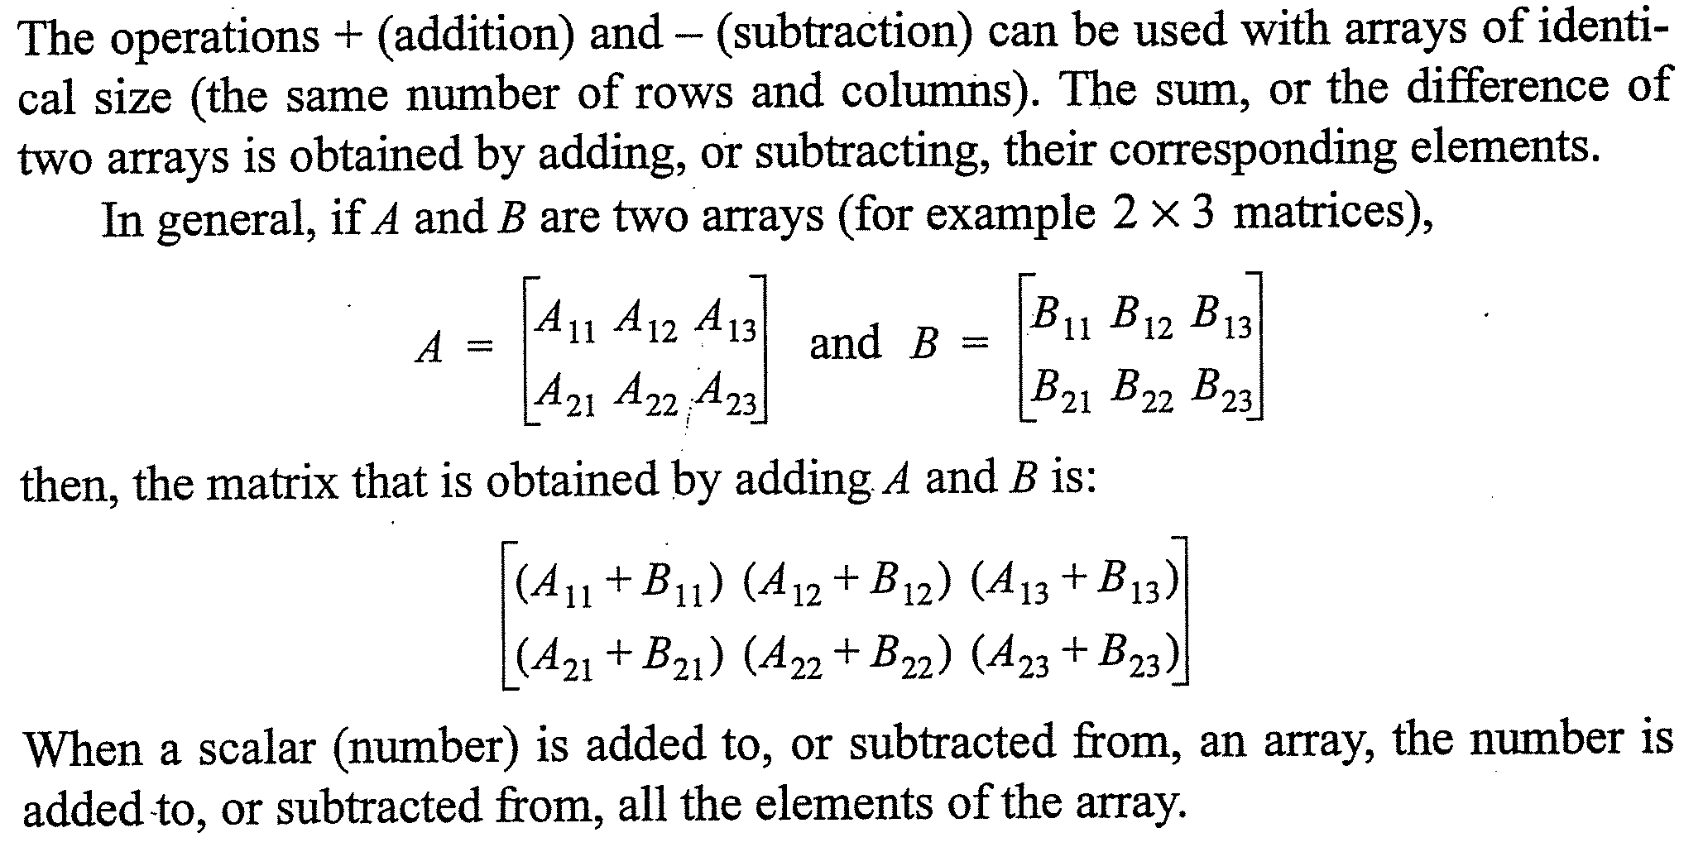
Addition and Subtraction

Slide 43
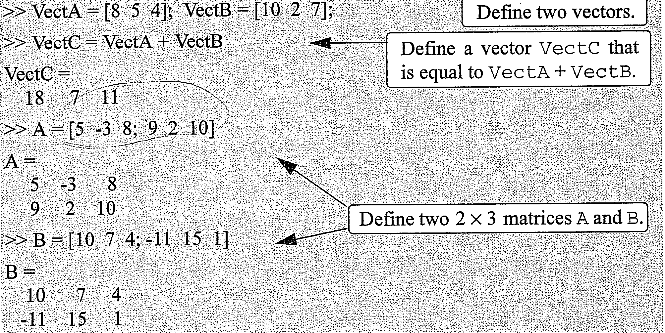
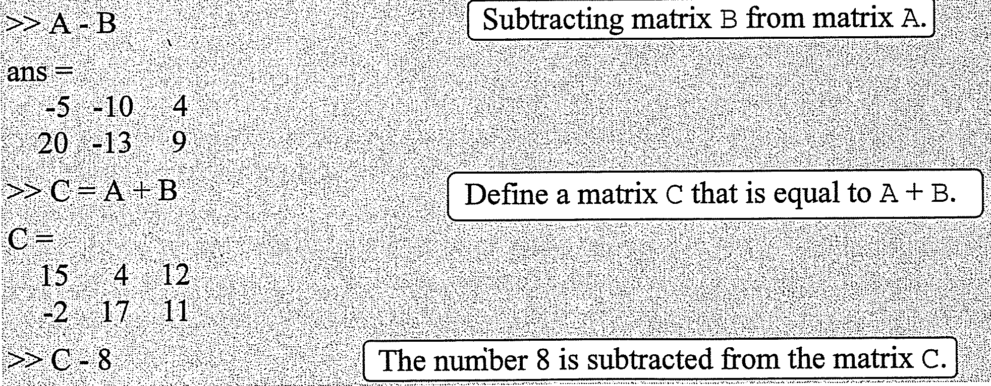
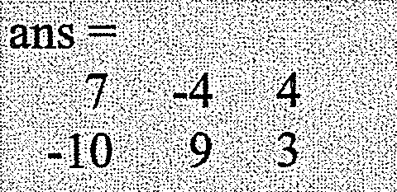
Addition and Subtraction

Slide 44
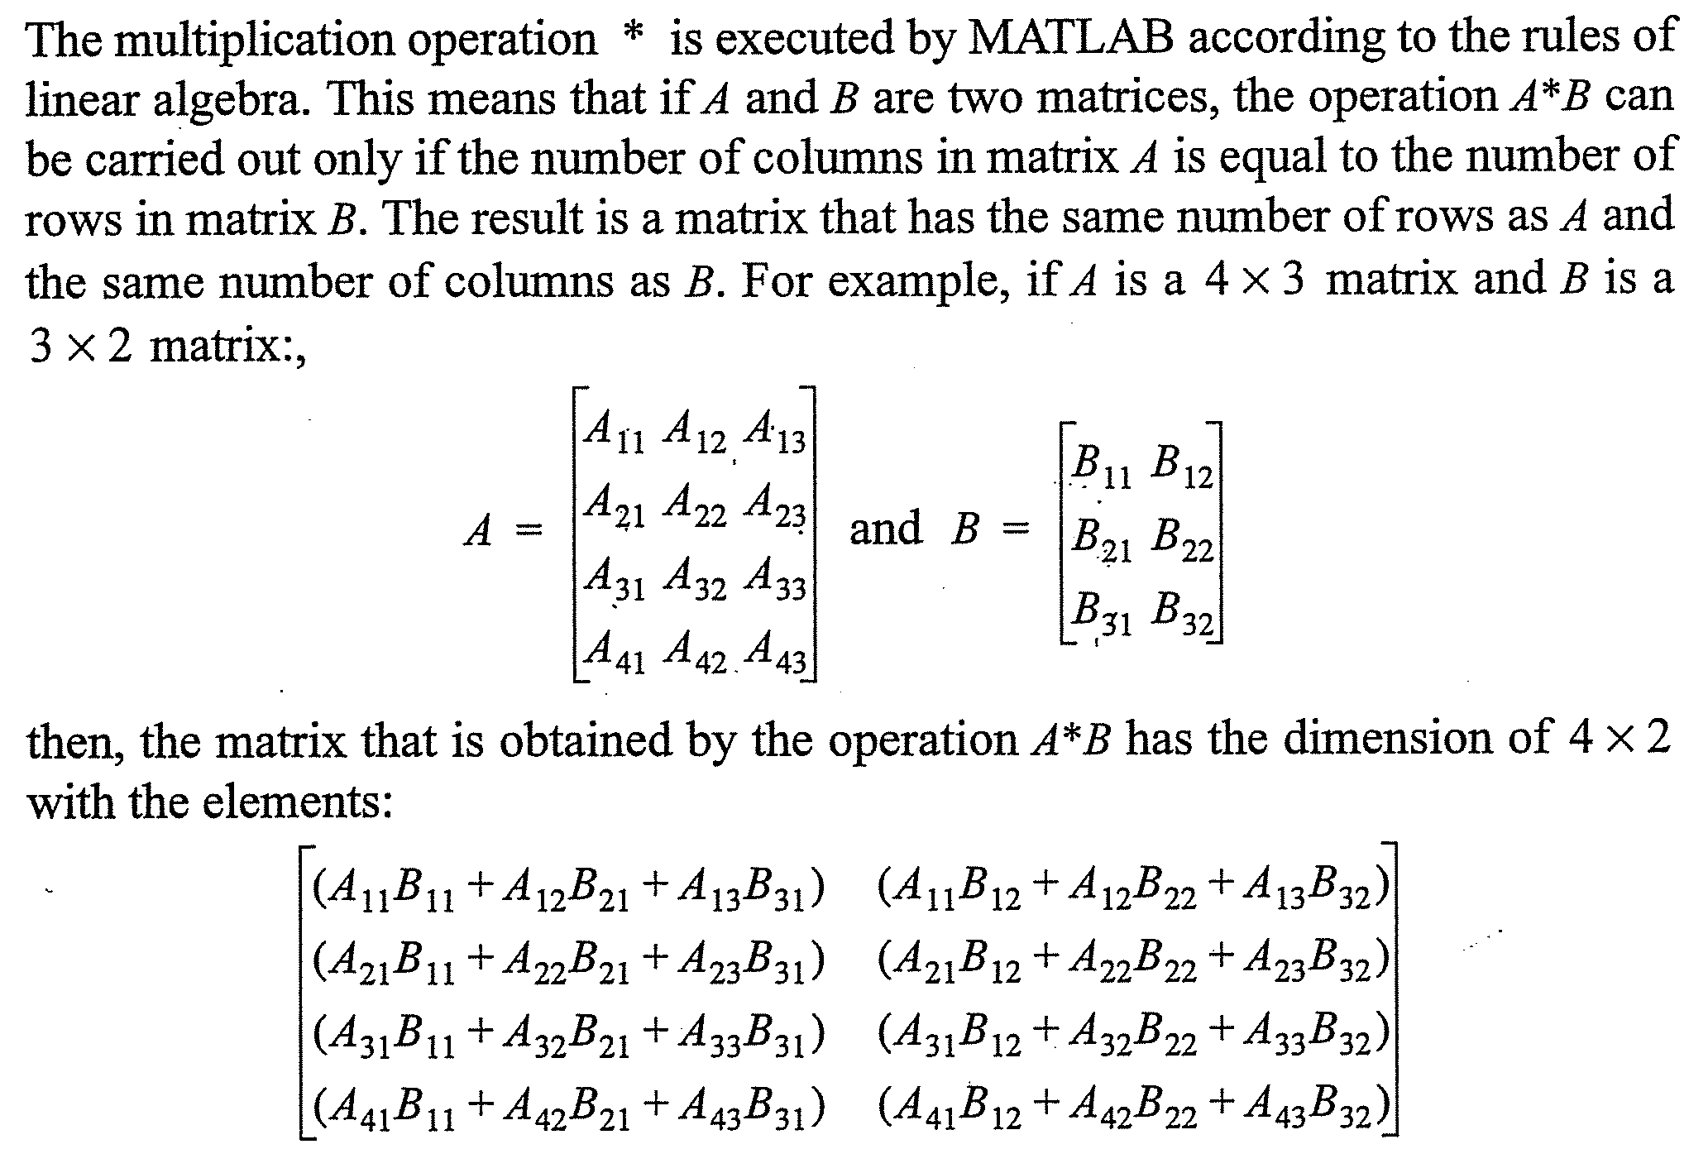
Array Multiplication

Slide 45
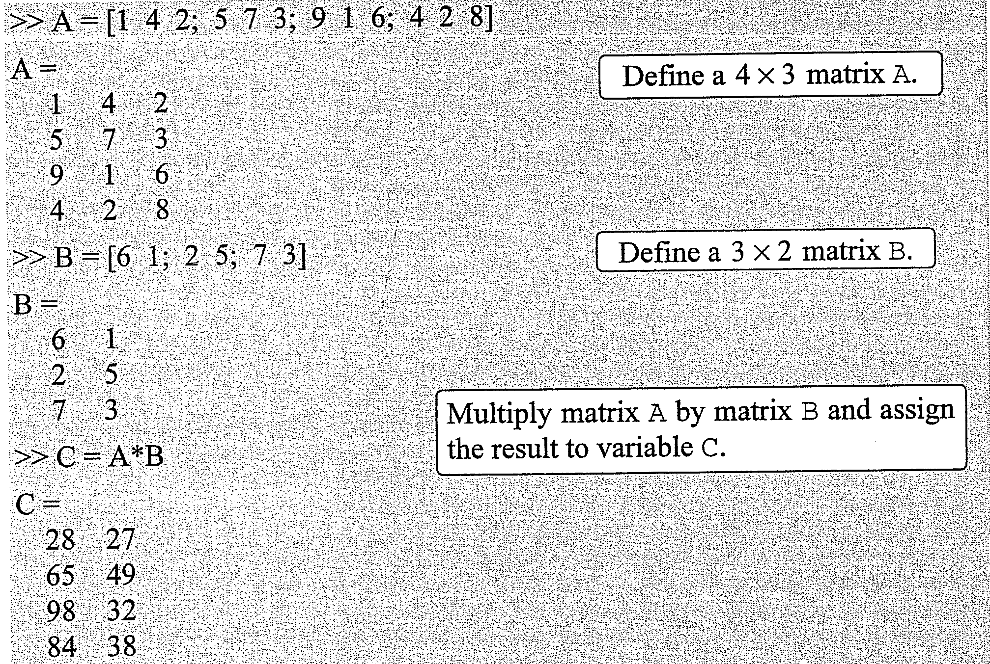
Array Multiplication

Slide 46
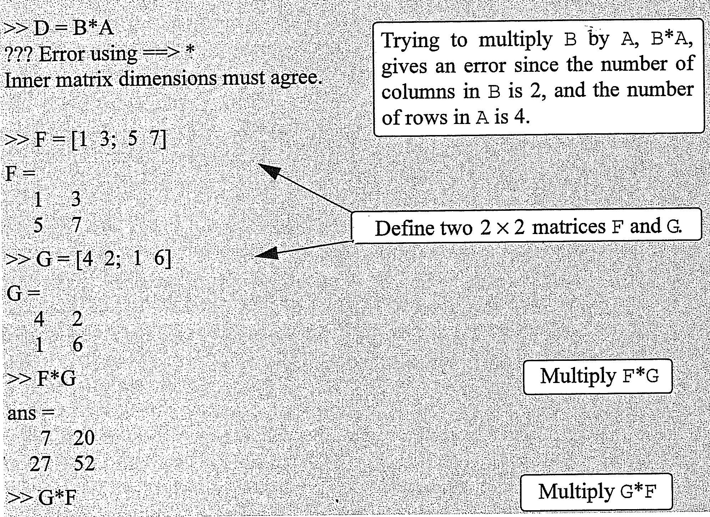
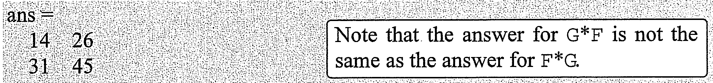
Array Multiplication

Slide 47
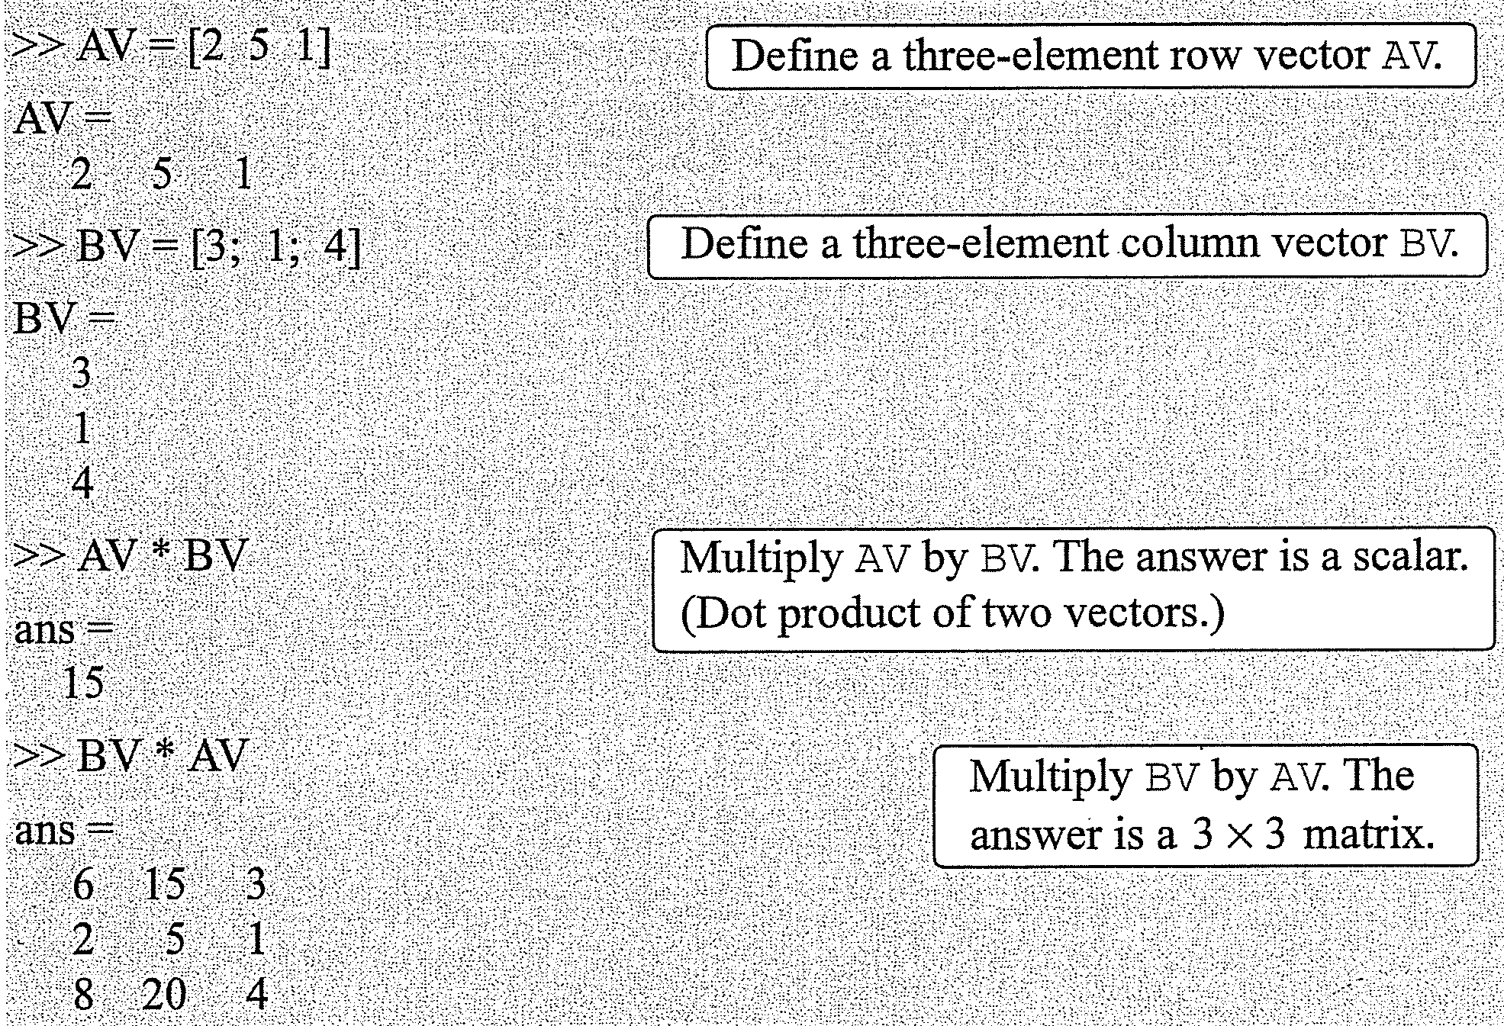
Array Multiplication

Slide 48
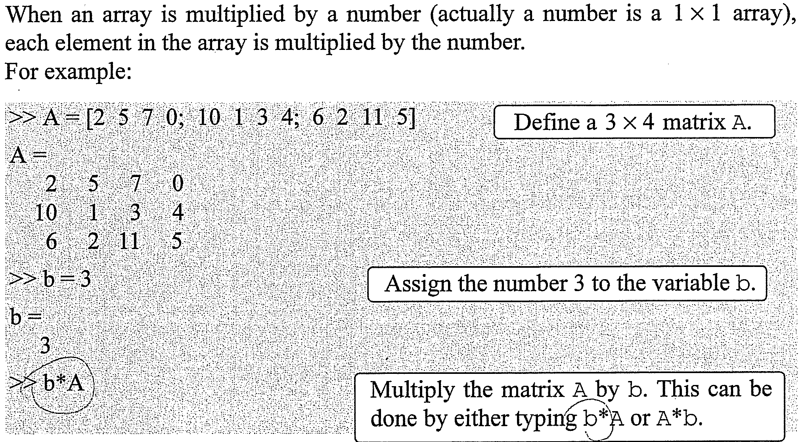
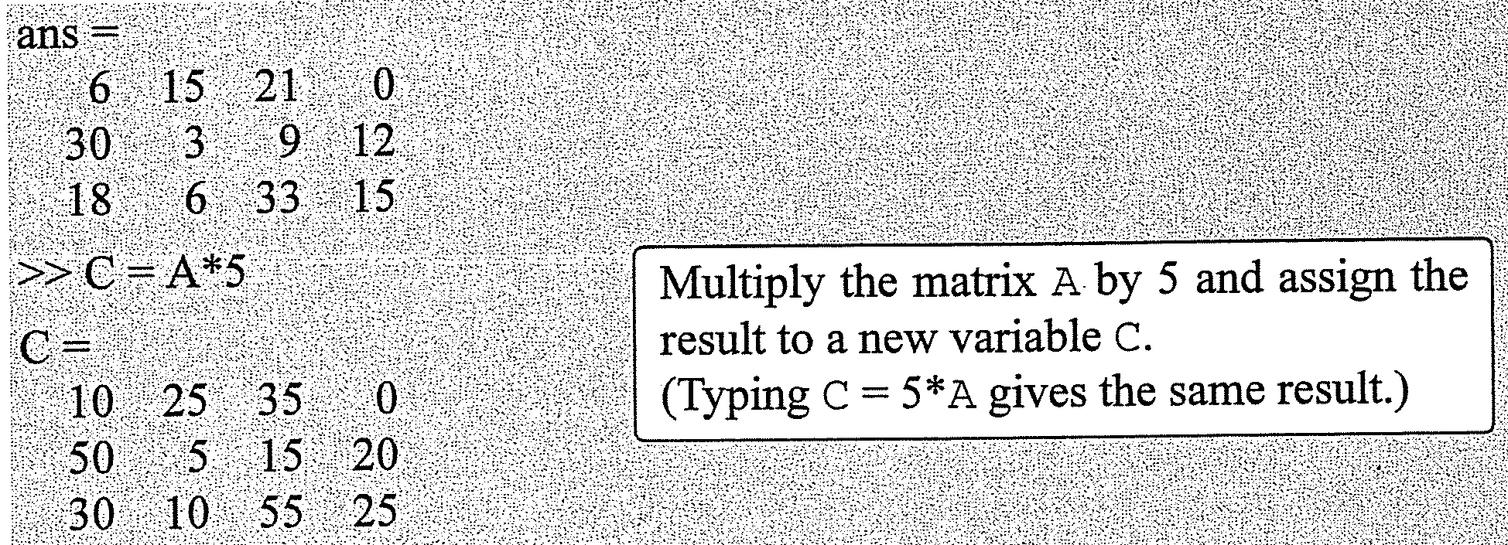
Array Multiplication

Slide 49
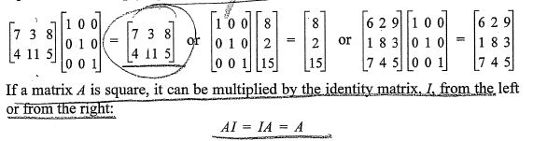
Array Division more complex
Identity Matrix (im)
Square matrix – the diagonal elements are 1’s, and the rest of the elements are 0’s
Can be created with eye command
When the im multiplies another matrix (or vector), that matrix (or vector) is unchanged.
This is equivalent to multiplying a scalar by 1.

Slide 50
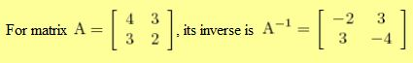
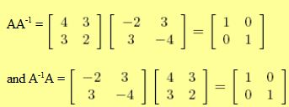
Array Division – Inverse of a Matrix
Matrix A⁻¹ is the inverse of the matrix A
When 2 matrices are multiplied, the product is the identity matrix
Both matrices must be square and the multiplication order can be AA⁻¹ or A⁻¹A
AA⁻¹ = A⁻¹A = 1
Command for inverse of a matrix is inv(A)

Slide 51
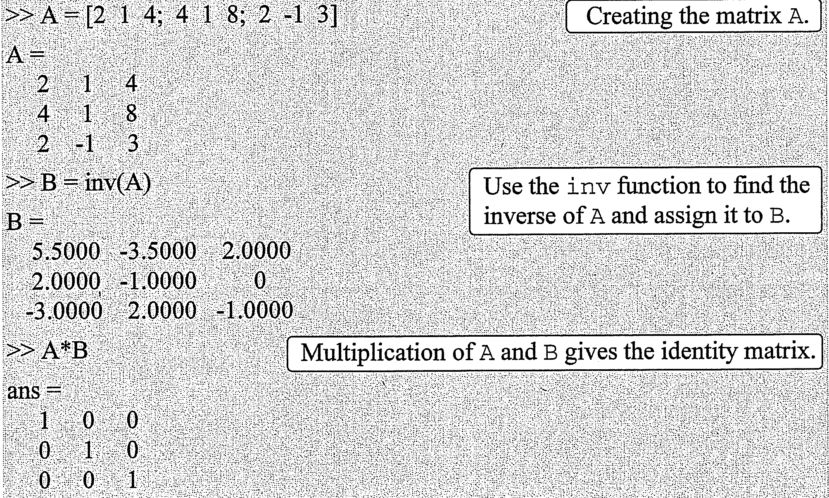

Array Division – Inverse of a Matrix

Slide 52

Array Division – Determinants
Command for determinant is det

Slide 53
Array Division – Left and Right Divisions
Left Division \
Used to solve AX = B (X and B are column vectors)
A⁻¹AX = A⁻¹B
A⁻¹AX = IX = X
The solution of AX = B is X = A⁻¹B
In MATLAB, the last eqn can be written as X = A\B
Right Division /
Used to solve XC = D (X and D are row vectors)
X.CC⁻¹ = D.C⁻¹
X = D.C⁻¹
In MATLAB, the last eqn can be written as X = D/C

Slide 54


Example
Use matrix operations to solve the following system of linear equations.
4x - 2y + 6z = 8
2x + 8y + 2z = 4
6x + 10y + 3z = 0
Solution
AX = B or XC = D

Slide 55

Solution (Cont.)

Slide 56



Element by Element Operations

Slide 57

Element by Element Operations

Slide 58


Element by Element Operations

Slide 59

Element-by-element calculations are very useful for calculating the value of a function at many value of its argument.
Define a vector that contains values of the independent variable, and then using this vector in element-by-element computations to create a vector in which each element is the corresponding value of the function.

Slide 60



Slide 61


Using Arrays in MATLAB Built-In Math Functions
Input: Array
Output: Result
If a vector with 7 elements is substituted in the function cos (x), the result is a vector with 7 elements in which each element is the cosinee of the corresponding element in x.
If argument variable is a matrix:

Slide 62
Built-In Functions for Analyzing Arrays
Function | Description | Example
mean (A) | If A is a vector, returns the mean value of the elements of the vector. | >> A = [5 9 2 4]; >> mean(A) ans = 5
C = max (A) | If A is a vector, C is the largest element in A. If A is a matrix, C is a row vector containing the largest element of each column of A. | >> A = [5 9 2 4 11 6 7 11 0 1] >> C = max(A) C = 11
[d, n] = max (A) | If A is a vector, d is the largest element in A, n is the position of the element (the first if several have the max value) | >> [d,n] = max(A) d = 11 n = 5

Slide 63
Built-In Functions for Analyzing Arrays
Function | Description | Example
min (A) | The same as max(A), but for the smallest element | >> A = [5 9 2 4]; >> min(A) ans = 2
sum (A) | If A is a vector, returns the sum of the elements of the vector | >> A = [5 9 2 4]; >> sum(A) ans = 20
sort (A) | If A is a vector, arranges the elements of the vector in ascending order | >> A = [5 9 2 4]; >> sort(A) ans = 2 4 5 9
median (A) | If A is a vector, returns the median value of the elements of a vector | >> A = [5 9 2 4]; >> sort(A) ans = 4.500
a < b < c < d → median is (b + c) / 2

Slide 64
Built-In Functions for Analyzing Arrays
Function | Description | Example
std (A) | If A is a vector, returns the standard deviation of the elements of the vector | >> A = [5 9 2 4]; >> std(A) ans = 2.9439
det (A) | Returns the determinant of a square matrix | >> A = [2 4; 3 5]; >> det(A) ans = -2

